Slide 1

1) Motive

Slide 2
2)a)i) Call records
 | Time | To | Duration | Tower | Notes
1 | 10:45 | J | 0:28 | L651A
2 | 12:07 | E Home | 0:21 | L688A | E = J’s friend; she testified that J came to her house the day of the murder around 13:00. This call is likely a good example of the tower data not guaranteeing that a call was made/received from the area typically covered by the tower/antenna it ends up being routed through. There is no reason for the 12:07 p.m. call to have been made in the L688A territory — it doesn’t fit any narratives, and no other calls are ever routed through L668. The most likely explanation is that the call was made within the territory typically covered by the tower directly to the west of L668, which is L651 – the school tower.
3 | 12:41 | E Home | 01:29 | L652A
4 | 12:43 | Incoming | 0:24 | L652A
5 | 14:36 | Incoming | 0:05 | L651B | Prosecution said this might have come from B. They proposed that after school ended at 2:15 p.m., B caught a ride in H’s car, and then strangled her to death in a parkin lot. B then used a pay phone to call his cell phone (which J had), and B told J to pick him up.
6 | 15:15 | Incoming | 0:20 | L651C | Location of where J says, he & B first leave H’s body & car. No evidence as to whom the 3:15 p.m. call was from.
7 | 15:21 | E Home | 0:42 | L651C
8 | 15:32 | N | 02:22 | L651C | N = B’s friend
9 | 15:48 | F | 01:25 | L651A | F = J’s friend
10 | 15:59 | P | 0:25 | L651A | P = J’s friend
11 | 16:12 | E Home | 0:28 | L689A
12 | 16:27 | Incoming | 02:56 | L654C
13 | 16:58 | Incoming | 0:19 | L654C | According to B this is when he likely called J to pick him up from training at school
14 | 17:14 | Voicemail | 01:07 | N/A | Incoming calls to voicemail do not provide location data.
15 | 17:38 | K | 0:02 | L653C | K = B’s friend
16 | 18:07 | Incoming | 0:56 | L655A | Likely to be a call from H’s brother
17 | 18:09 | Incoming | 0:53 | L608C
18 | 18:24 | Incoming | 04:15 | L608C | Likely to be the call from the police about H’s disappearance
19 | 18:59 | Y Mobile | 0:27 | L651A | Y = B’s friend
20 | 19:00 | E Pager | 0:23 | L651A | B pretty sure he had his phone back at this point and was attending prayers. J says that he paged E from the burial site with this call.
21 | 19:09 | Incoming | 0:33 | L689B | Prosecution used this to locate B to the burial site. Jenn says she was calling and that someone other than J answered the phone saying that J would call her back.
22 | 19:16 | Incoming | 0:32 | L689B | The 7:09 p.m. and 7:16 p.m. calls are the two most significant calls in the case, because both calls were routed through L689B — which is the tower/antenna whose range is almost exclusively limited to the southwest leg of the park where H was buried.
23 | 20:04 | E Pager | 0:32 | L653A | At trial, E testified that “[b]etween 8:00-8:15 p.m., [she] got a message from [J] to pick him up at [the shopping centre] in 15 minutes, so she left and picked him up.” Jenn arrived there first. When J and B arrived, “[B] was . . . driving, and said hello to [E]. [J] got in her car and said . . . ‘[B] strangled H in [a] parking lot. [I] saw her body in the trunk.’ . . . [B] used [J’s] shovels to bury her and [J] wanted to make sure there were no fingerprints on them.”
24 | 20:05 | E Pager | 0:13 | L653C | The 8:04 and 8:05 calls show that whoever has the cell phone was probably somewhere the road where H’s car was abandoned (J later led police to where the car had been ditched), these calls are almost certainly showing the killer abandoning the car after burying her body.
25 | 21:01 | N | 01:24 | L651C | N = B’s friend

Slide 3
2)ii) Call records
 | Time | To | Duration | Tower | Notes
26 | 21:03 | K | 05:28 | L651C | K = B’s friend
27 | 21:10 | K | 08:41 | L651C | K = B’s friend
28 | 21:57 | N | 0:24 | L651C | N = B’s friend
29 | 22:02 | Y | 0:06 | L698B | This call is another good example of a call routed through a cell tower outside of its normal range. There is no reason to believe — regardless of which witness’s testimony is accepted — that B was anywhere other than at his home at this time, or that he was out somewhere moving around at 10:02 p.m. at night. B was almost certainly at home, and, by chance, his call to Y was routed through the tower directly south (L698), rather than through the tower that calls made from B’s home are most commonly routed through (L651).
30 | 22:29 | D | 0:18 | L651C | D = B’s friend
31 | 22:30 | A | 01:44 | L651C | A = B’s friend

Slide 4
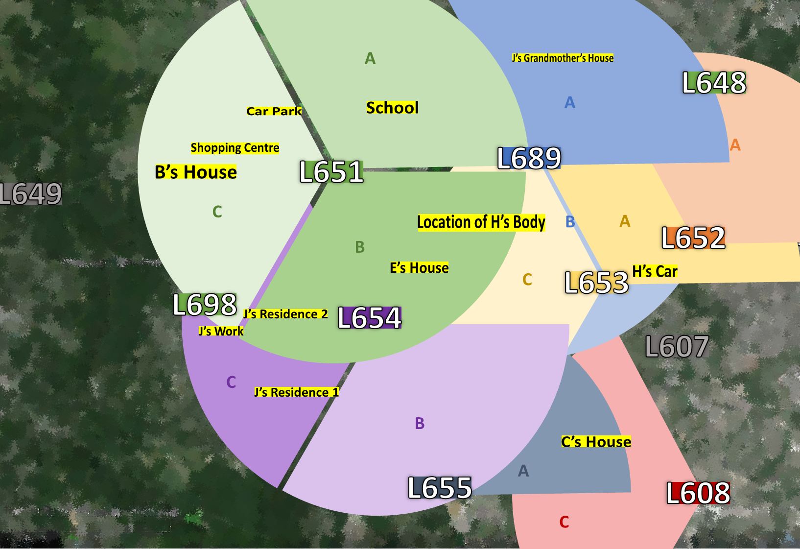
2)b) Map of phone towers & locations of interest

Slide 5
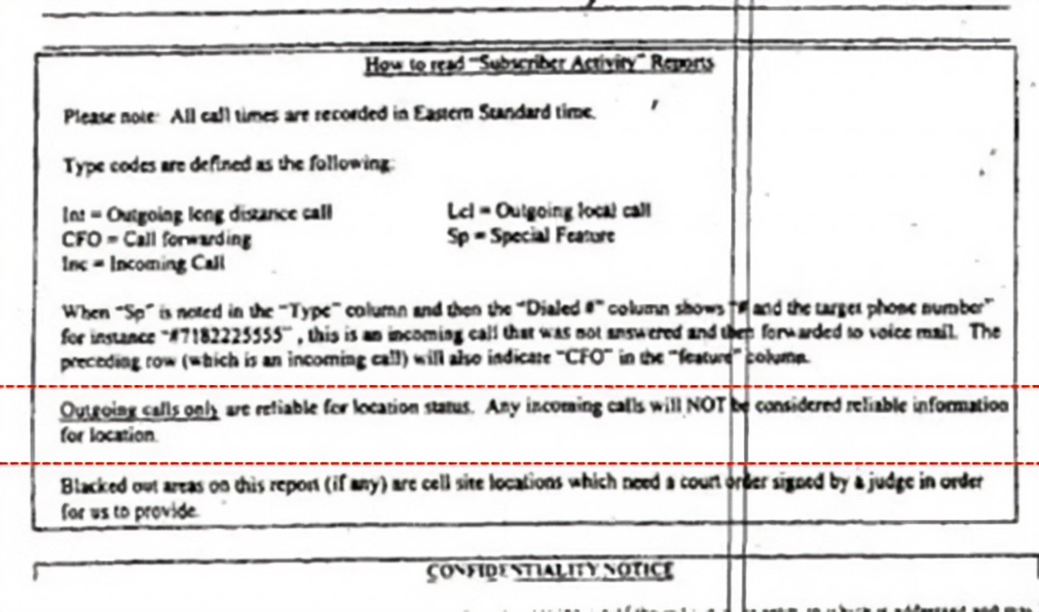
2)c) Cover sheet information submitted with call records
Outgoing calls only are reliable for location status. Any incoming calls will NOT be considered reliable information for location.

Slide 6
3)a) Written testimony 1
Written testimony 1 Ex-boyfriend's friend, J:
“It was my girlfriend’s birthday and B had said he’d help me buy her a gift. He came by my house in his car from school and picked me up to bring us to the shopping centre. On the way he told me he was going to kill H. I didn’t take it seriously but after shopping he gave me his car and mobile phone and got me to drop him back at school. He told me he was going to call me on that phone after he killed her and that I was to come meet him in his car to pick him up again. I went to my friend E’s house to hang out.
Later that day he did call and told me where to meet him. I met him in a car park and that’s when he showed me H’s body. He had put her in the boot of her car. We drove around for a while, him driving H’s car, me driving his, and then he abandoned her car. We went cruising for a bit and then he told me to drop him back off at school so that he could be seen at training for an alibi. On the way he was bragging and all proud about how he had killed H.
I collected him again after training and we went to my friend C’s house, then B got a call from H’s family. He got worried about where he had left H’s body with her car so we went back to get it. We got shovels from my house, got H’s car and then headed to the park to bury her. We dug a shallow hole in the woods and left her there around 8pm and I got picked up by my friend E.”

Slide 7
3)a) Written testimony 2
Written testimony 2: Ex-boyfriend, B:
“It didn’t happen, none of this is true at all. I must have had a free period that morning because I know I went to J’s to check if he had bought a gift for S’ birthday, S is my friend and J's girlfriend. J said he hadn’t gotten S anything so I offered him my car to go pick her up something. I went back to school and then after school finished, I probably went to the library to use the computer before training. I would have had athletics training that day, I always go.
I think J then picked me up from school to give me back my car and phone. We probably hung out before I went home around 7pm. I don’t remember where we went. I know I would have had to go home around 7 to go to prayers with my Dad.
But this was 6 weeks ago, it was just a normal day, I don’t remember exactly what I was doing but I didn’t kill H!”

